Slide 1
Meadow Lake Mechanical Pulp Submission to the Saskatchewan Rate Review Panel
Saskatoon, SK
October 16th, 2017
Paul Orser – Director of Government Relations and Business Development

Slide 2
Flow of the Presentation
Information on Meadow Lake Mechanical Pulp (MLMP) as it relates to sector/regional importance and why power rate increases are such an issue,
MLMP’s competition and their power cost circumstances,
A summary of past/proposed power rate increases,
Points related to the proposed increases,
Recommendations for the Panel to consider.

Slide 3
Meadow Lake Pulp – Economic/Social Impact From SJ Research Services Inc. Operations Benefit Footprint Study - 2016
Gross Domestic Product Impact: $204,600,000
Direct/Indirect/Induced Employment: 716 jobs
Labour Income: $45,700,000
Taxes/Resource Revenue Generated: $41,500,000
Only user of softwood chips in Saskatchewan: 350,000+ m³
It is the anchor of the integrated Saskatchewan Forest Industry.

Slide 4
The Context of Today’s Discussion
Why it is important to address issues early (when time offers more solutions). Before they become overwhelming and only limited or poor options are at hand to address the situation.
Notes:
We are not facing crisis change just yet but we could be on that path.
We want to take steps to avoid crisis change
We need your favourable recommendations to help avoid getting into a crisis situation

Slide 5
Key Points on MLMP’s Cost Structure
Primarily because of where Saskatchewan is located, Meadow Lake has a competitive disadvantage on freight to market costs. Almost all of MLMP’s production goes to Asia. All our competition has lower freight costs.
Because of past (and scheduled ) power rate increases Meadow Lake has a competitive disadvantage on power costs. More on that in a later slide.
And that disadvantage could well grow in magnitude because SaskPower has signaled they will continue increasing rates indefinitely.

Slide 6
A Brief Review of the MLMP Situation
MLMP purchases in the order of $50 million per year in power.
Over the last 5 years the average increase was over 5% per year.
In 2018 another 5.1% increase is scheduled.
Our direct competition is not seeing this cost escalation.
Our business cannot support this type of increase over the selling cycle.
If the mill is unable to show a mitigation plan, it puts a red flag up regarding winning future investment.

Slide 7
MLMP’s Cost Structure and Why (large) Power Rate Increases Threaten the Mill

Slide 8
Elements of the Mill’s Increasing Power Cost Mitigation Strategy (not all being advanced)
There are a variety of measures to reduce the cost of the electricity MLMP uses:
Individually, and with the Saskatchewan Industrial Energy Consumers Association (SIECA), analyze and challenge the basis, magnitude and timing of proposed increases.
Advocate for R/RR ratio of 1:00 for Industrial users.
Fully analyze and have rates reflective of the mill’s power use profile and specific cost drivers of the E85 Rate Code.
Seek changes to the Industrial Energy Optimization Program, (which results in a reduced power use intensity at the mill) to better reflect a customers size as it relates to power purchased.
Look at self-generation options - which includes gas.
Obtain a load retention power contract. (Crisis change)

Slide 9
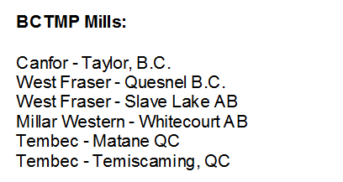
Meadow Lake’s Canadian Competition
We do not have their specific power rates, but the next slide illustrates that it is a safe assumption they are all lower than ours. In some cases significantly lower. And they are not facing increases in the > 5% range annually.
Notes:
The new BC government have in their platform a freeze in power rates.
Also kept in their September budget the previous governments reduction and elimination of the PST on electricity.

Slide 10
A High Level Illustration of the Higher Saskatchewan Costs
MLMP’s Canadian Competition are in these regions
From the 2017Elenchus
Cost of Service Study
Notes:
Should note that Saskatchewan had a subsequent 3.5% increase in January of this year.

Slide 11
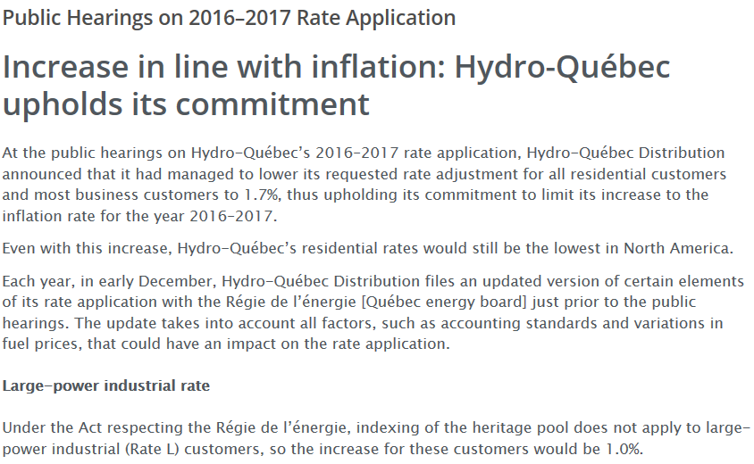
Of note is a desire to keep increases related to inflation - less rate shock
And they clearly recognize the need for industrial competitiveness
Notes:
With respect to R/RR and the bias, over the long term, that sees power rate class always above residential signals, this jurisdiction has different set of criteria or policy compared to Saskatchewan.

Slide 13
Greater than 5% per Year Power Rate Increases Drives an Uncompetitive Cost Structure

Slide 14
Points Specifically Related to the Rate Increase Why the 5% Increase is Required
In most businesses, coincidentally (i) increasing the capacity of the business, (ii) intensively renewing existing infrastructure, (iii) not only increasing, but hitting return on equity “targets” and (iv) reducing debt at the same time, just does not happen.
Is it reasonable to expect that all these outcomes should be fulfilled at the same time?

Slide 15
Points Specifically Related to the Rate Increase Excerpts from the Rate Review Panel Terms of Reference

Slide 16
Points Specifically Related to the Rate Increase Selected Points Drawn from the SIECA Brief
“SIECA strongly believes that SaskPower can achieve most, if not all, of its objectives by simply continuing to focus on controlling its spending and not continuing to increase sales rates.”
“SIECA would suggest that since SaskPower has had a rate increase in 2017 and that SaskPower’s response to the consultant’s final report needs analysis and assessment; SaskPower should not be requesting a 5.1% rate increase effective March 1, 2018, but rather bringing forward a rate increase later in 2018 if necessary after all information is analyzed.”

Slide 17
Points Specifically Related to the Rate Increase A Review of Return on Equity

Slide 18
Excerpts from the Rate Review Panel Terms of Reference

Slide 19
Points Specifically Related to the Rate Increase Some Points to Ponder
There is some question that SaskPower needs the (or the full) rate increase to meet their ROE “target”. Why not err on the customer side?
There are more questions as to the fairness of going straight to that target when it is described in the CIC Minister’s Terms of Reference as a “long term target”.
A Cost of Service Study has been completed. That study identifies a need to rate rebalance. Why put a large rate increase (and 5% is large) through when evidence exists that some customers are not being equitably treated? Why not implement a smaller, or no increase, and get it right some several months later?

Slide 20
Points Specifically Related to the Rate Increase Recommendations for the Panel to Consider
The following are recommendations put forward for the Rate Review Panel to consider;
That the March 1, 2018 increase be reduced by at least 50%,
That the Panel provides direction to SaskPower to aggressively review capital expenditures including the setting a “target” percentage for deferral or reduction over the next two years,
Only in the event SaskPower is not achieving balanced financial metrics, later in 2018 SaskPower would submit another rate increase application, with this one incorporating the findings of the COSS and which includes addressing any biases in the R/RR between classes of service.

Slide 21
Thank you for your attention. Any questions?

