Slide 1

SaskPower’s
2016 and 2017 Rate Application
PUBLIC MEETING - SASKATOON
JUNE 23, 2016

Slide 2
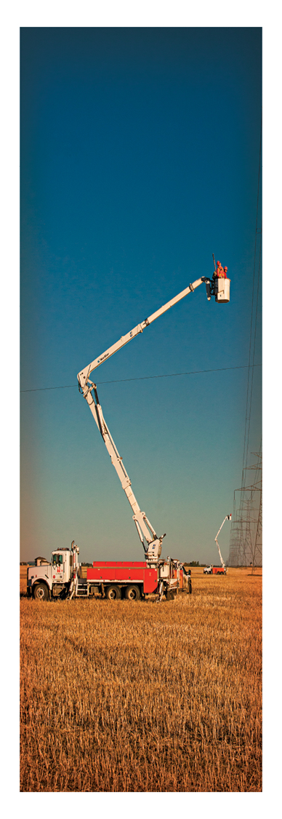
2016 and 2017 Rate Application
SaskPower is requesting a system average rate increase of 5% effective July 1, 2016, and 5% effective January 1, 2017.
This is a flat rate increase – no rate rebalancing.
The primary driver of SaskPower’s need for rate increases is our capital spend.
The rate increases enable SaskPower to meet our ROE target of 8.5% in 2017/18 and keep our debt ratio around 75%.

Slide 3
Customer Impact

Slide 4
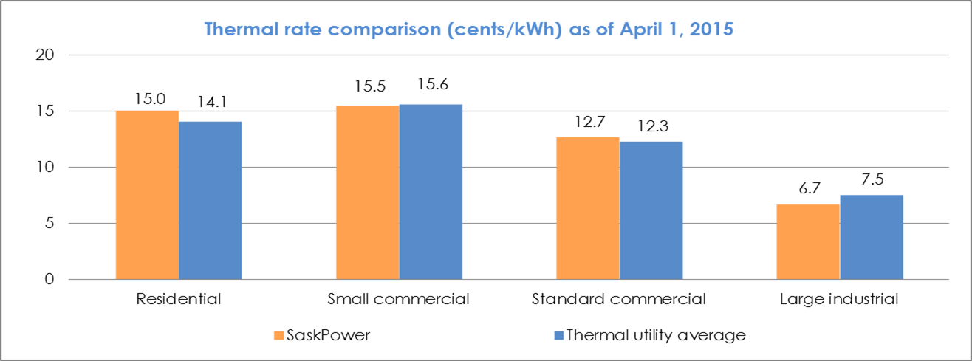
Customer Rate Comparison
SaskPower’s rates are currently comparable to those charged by other thermal utilities in Canada.
However, our residential rates are about 7% higher than the thermal average.
SaskPower’s other classes are on par or slightly better than other thermal utilities.

Slide 5
Aging Infrastructure
Coal generation capacity largely built in 1970s and 1980s (34% of generation capacity).
Hydro generation was constructed in late 1950s and 1960s with some as early as 1930s (20% of generation capacity).
Nearly 70% of over one million distribution poles were installed prior to 1990 and have a mean age of 38 – industry recommended average age is 25.
Most of the transmission system was built between 1950 and 1980.

Slide 6
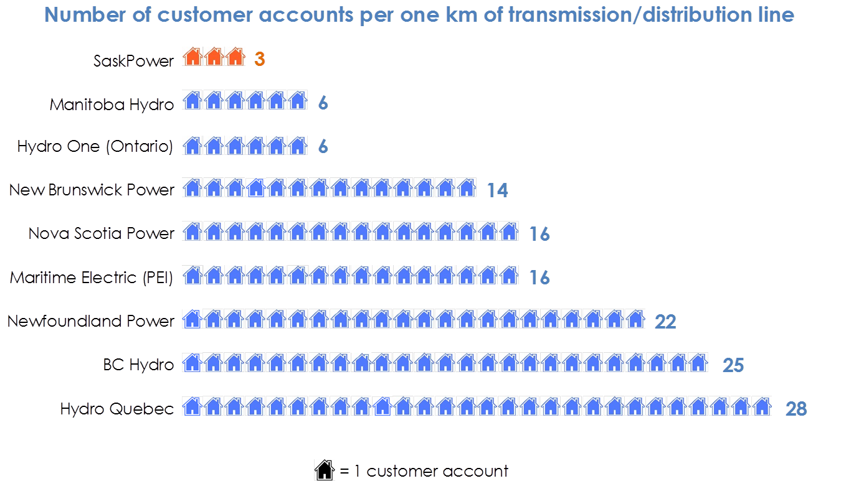
Customer Density

Slide 7
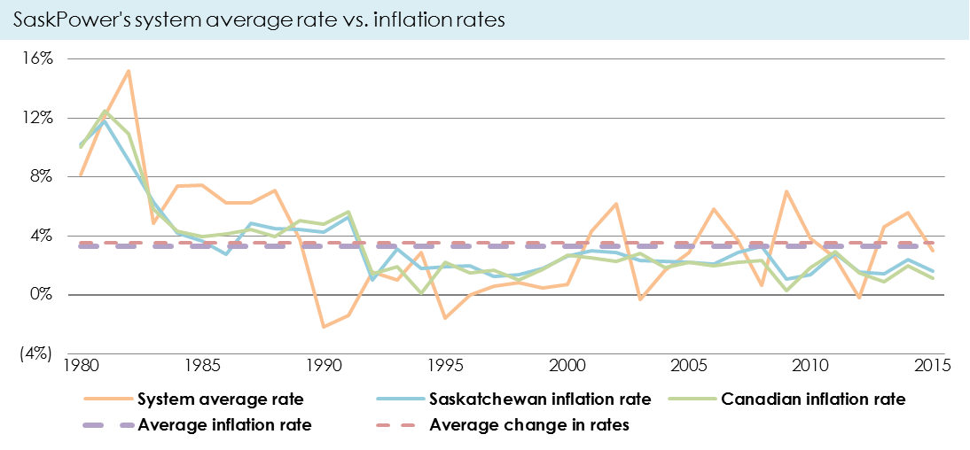
Historical Rate Increases vs Inflation
SaskPower’s system average rate increases have increased at approximately the same rate as inflation (3.5% vs 3.3% respectively).

Slide 8
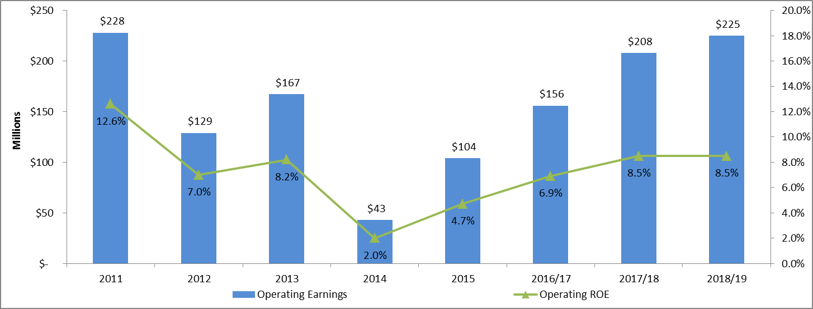
Operating Income and Return on Equity
This rate application is intended to bring SaskPower’s Operating ROE back to its targeted level of 8.5%.
SaskPower’s operating income excludes the impact of unrealized gains / losses on financial instruments.

Slide 9
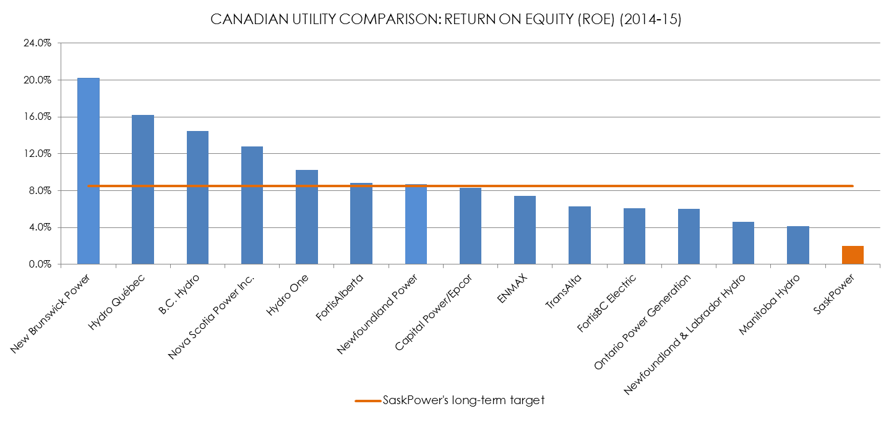
Return on Equity Benchmark

Slide 10
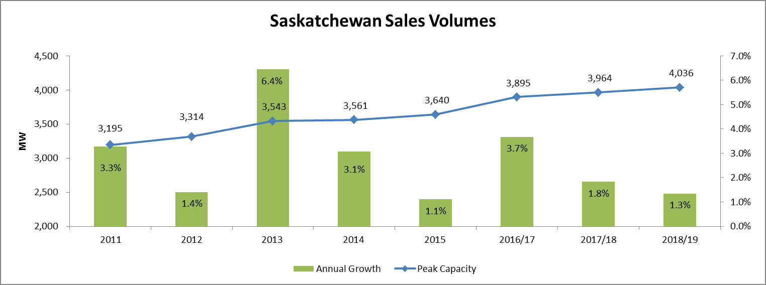
Forecasted Load Growth
The higher load growth in 2016/17 is due in part to the warmer than normal weather in 2015. This understates the growth in 2015 and overstates the growth in 2016/17 (about 1%).

Slide 11
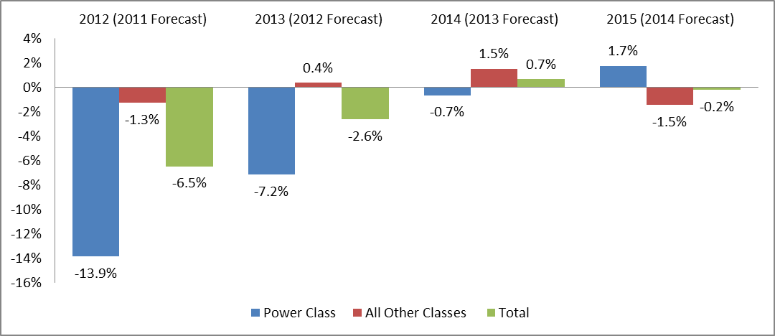
Normalized Energy Sales Variance
SaskPower has modified the way we forecast Power Class demand by using a combination of customer information and independent economic data.

Slide 12
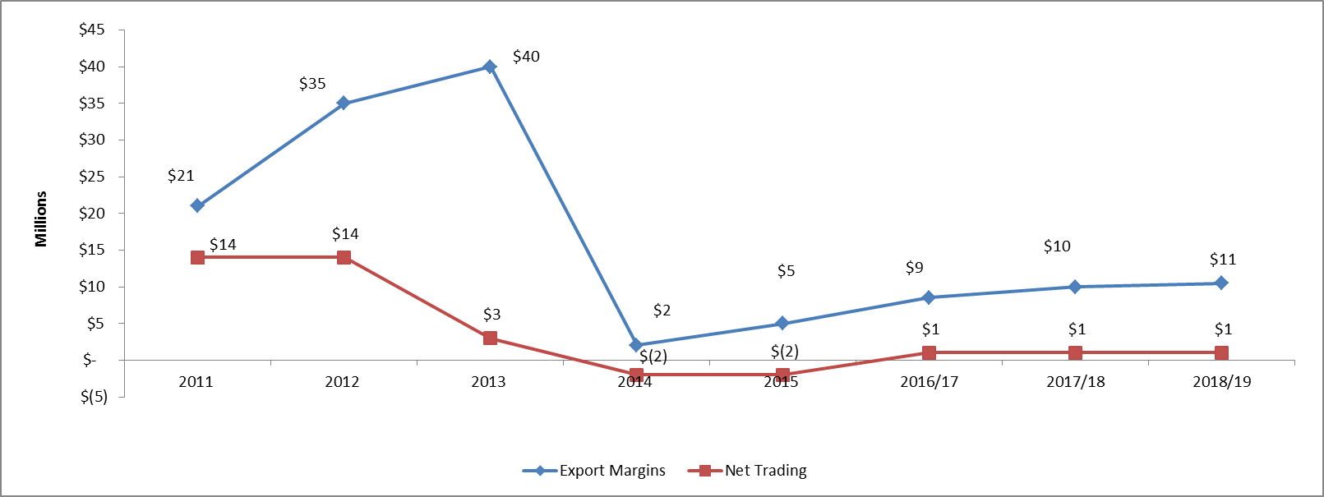
Exports and Trading Margins
SaskPower has seen a dramatic decrease in export and trading margins as a result of soft market conditions in Alberta.

Slide 13
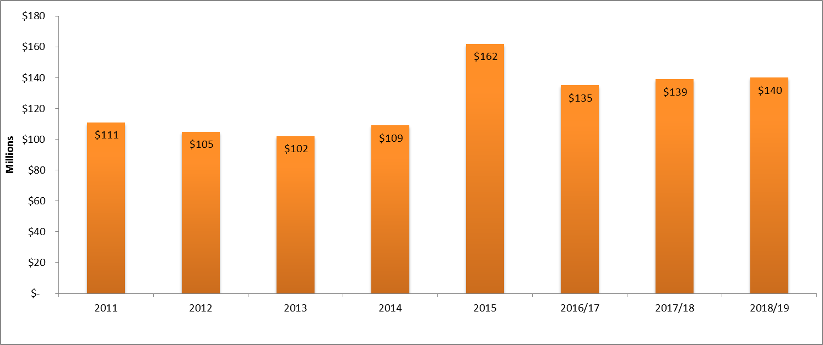
Other Revenue
Other revenue increased dramatically in 2015 as a result of record customer contributions.
The figure is also driven higher by Clean Coal Test Facility and CO2 revenues.

Slide 14
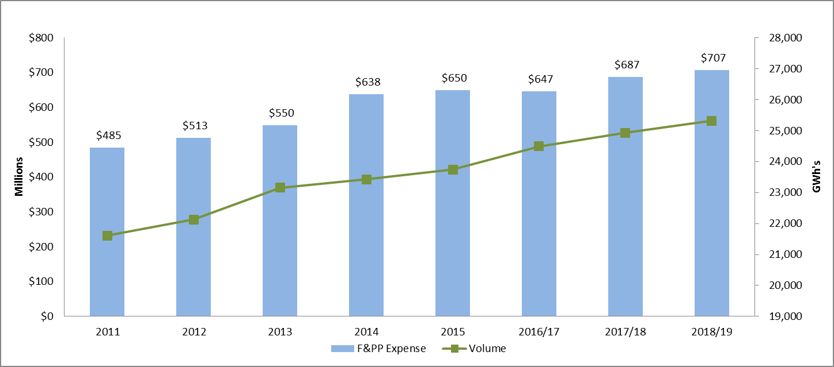
Fuel and Purchased Power
SaskPower’s fuel and purchased power forecast is driven largely by natural gas prices, hydro availability and energy sales volumes.

Slide 15
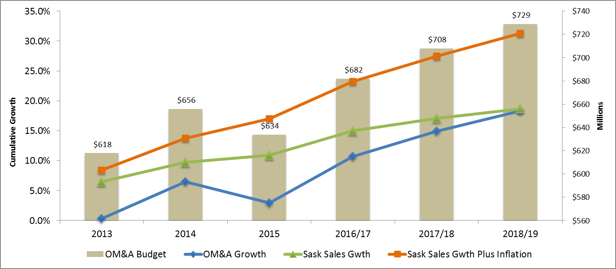
Operating, Maintenance and Admn.
SaskPower is focusing on keeping its OM&A growth at the level of growth in Saskatchewan sales.

Slide 16
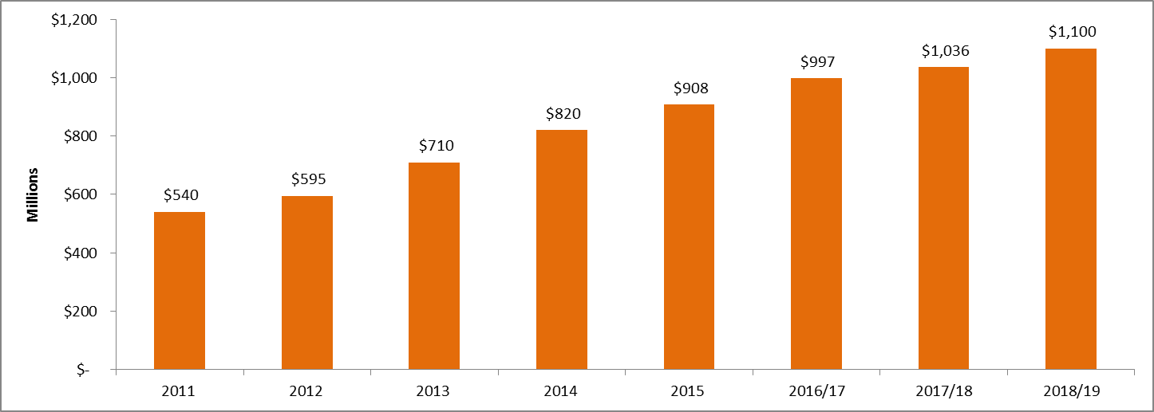
Capital Investment Expense
Capital investment expense includes depreciation, finance charges, capital taxes and other expense.
This is the primary driver of SaskPower’s increase in expense.

Slide 17
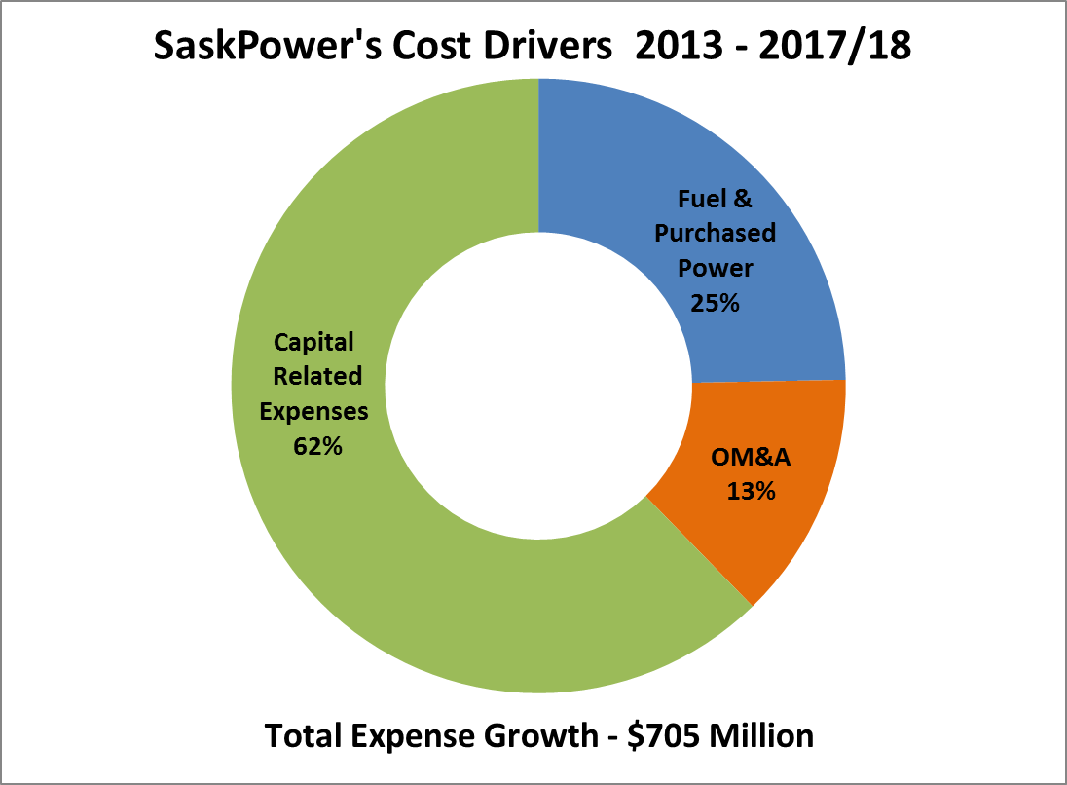
SaskPower Rate Increase Drivers

Slide 18
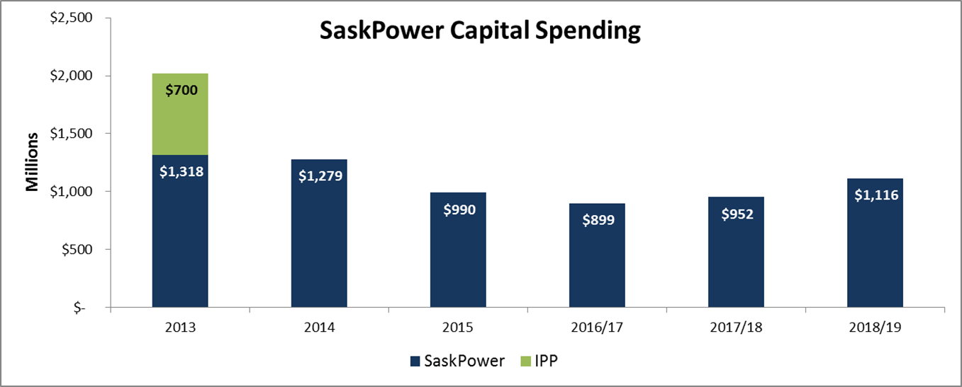
Capital Investment
SaskPower’s capital spending is required to meet the growth in the province and address sustainment investment needs.

Slide 19
Capital Investments

Slide 20
Capital Investments
Sustainment Investments
Transmission Wood Pole Remediation Program ($372M over next 5 years).
Circuit Breaker and Relay Replacement Program ($60M over next 5 years).
Rural Rebuild and Improvement Program ($96M over next 5 years).
Distribution Wood Pole Remediation Program ($126M over next 5 years).
E.B. Campbell Life Extension ($245M – complete in 2025).
Growth and Compliance Investments
Pasqua to Swift Current Transmission Line ($260M – complete in 2019).
Kennedy to Tantallon Transmission Line ($113M – complete in 2017).
Regina to Pasqua Transmission Line ($100M – completion date TBD).
Tazi Twe Hydroelectric Station (approx. $630M – completion date TBD).
Distribution Customer Connects ($509M over next 5 years).

Slide 21
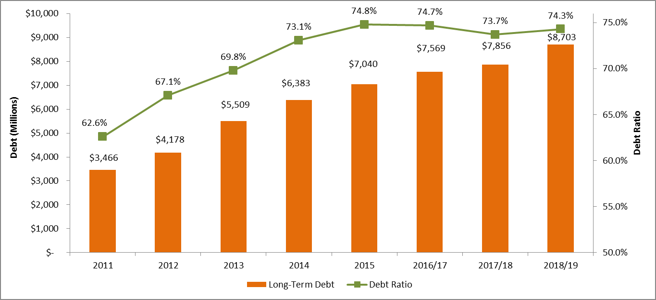
SaskPower’s Debt and Debt Ratio
As a result of SaskPower’s record capital investment, debt levels have doubled from 2011-15 and our debt ratio is approaching 75%.

Slide 22
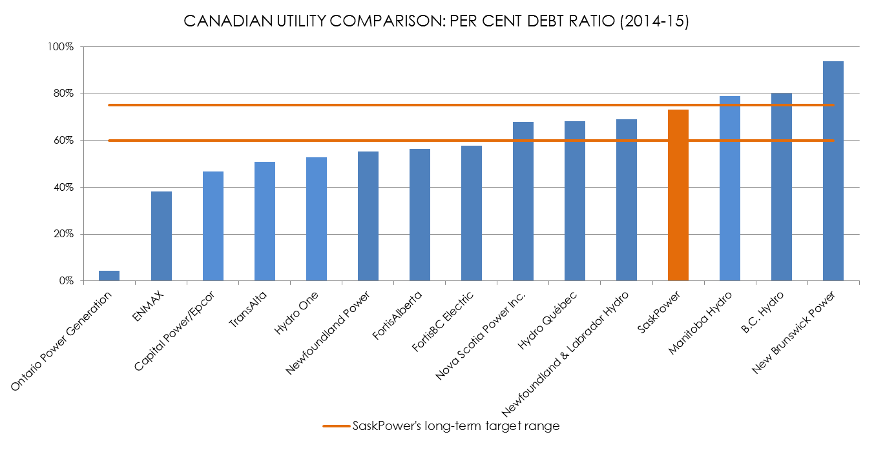
Debt Ratio Benchmark

Slide 23
Reducing the Impact of Rate Increases

Slide 24
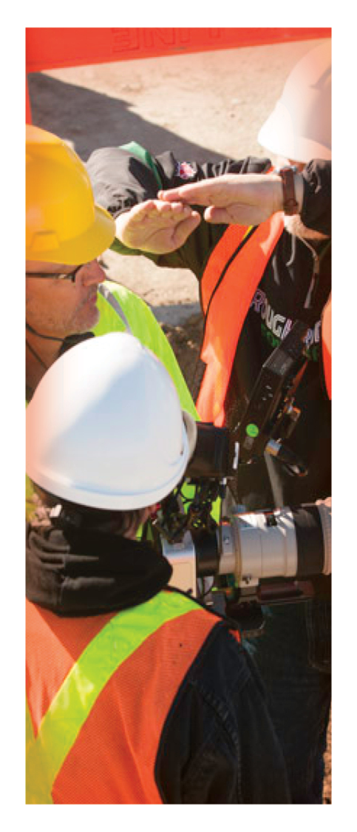
Summary
The rate increases are required primarily to fund SaskPower’s capital investments.
SaskPower expects to meet its targeted ROE of 8.5% in fiscal 2017/18.
The rate increases will permit the Corporation’s percent debt ratio to stabilize at 75%.
Without the rate increases, the financial health of the Corporation would be at risk.
The request is consistent with the Corporation’s strategy of capping annual rate increases at 5% or less.

Slide 25
QUESTIONS

